Slide 1
Astrid Linder
Project VIRTUAL
In Brief
Event: VIRTUAL-OSCCAR workshop
Location: On-line
Date: 8/09/2020

Slide 2
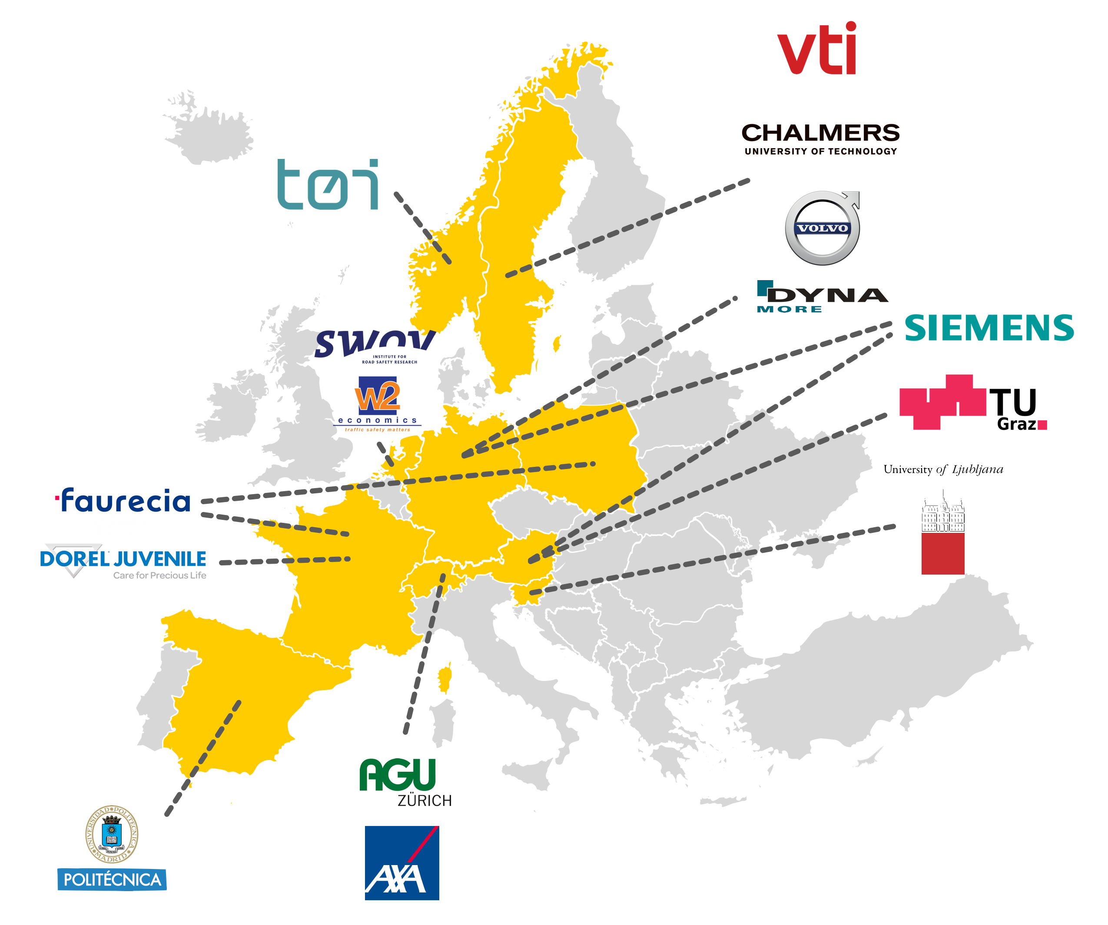

VIRTUAL: Open Access Virtual Testing Protocols for Enhanced Road User Safety
Duration: 48 Months, started 1 June 2018
Funding: € 6.99 Million
Partners: 15
Countries: 9
www.projectvirtual.eu
Aims:
Reduce loss of life and health in road crashes for all road users.
Share and foster knowledge: Open Source (OS).
Identify protective innovations: Virtual Testing, OS-HBM 50F and 50M.

Slide 3
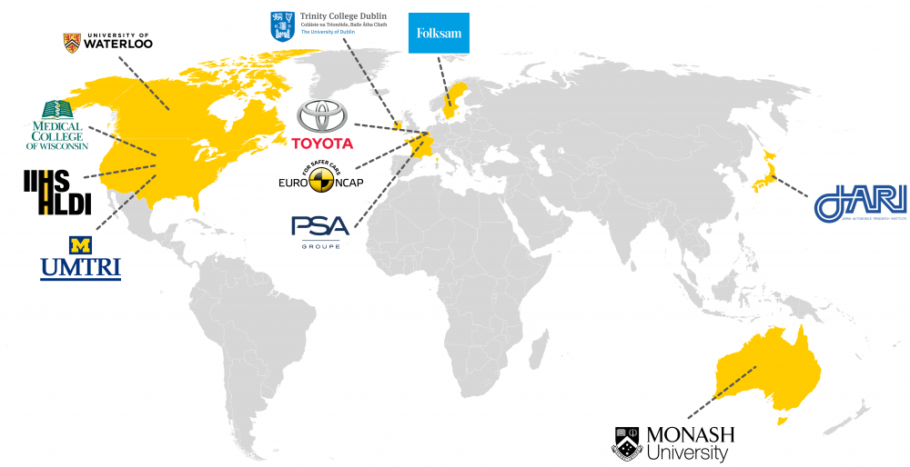
International collaboration

Slide 4
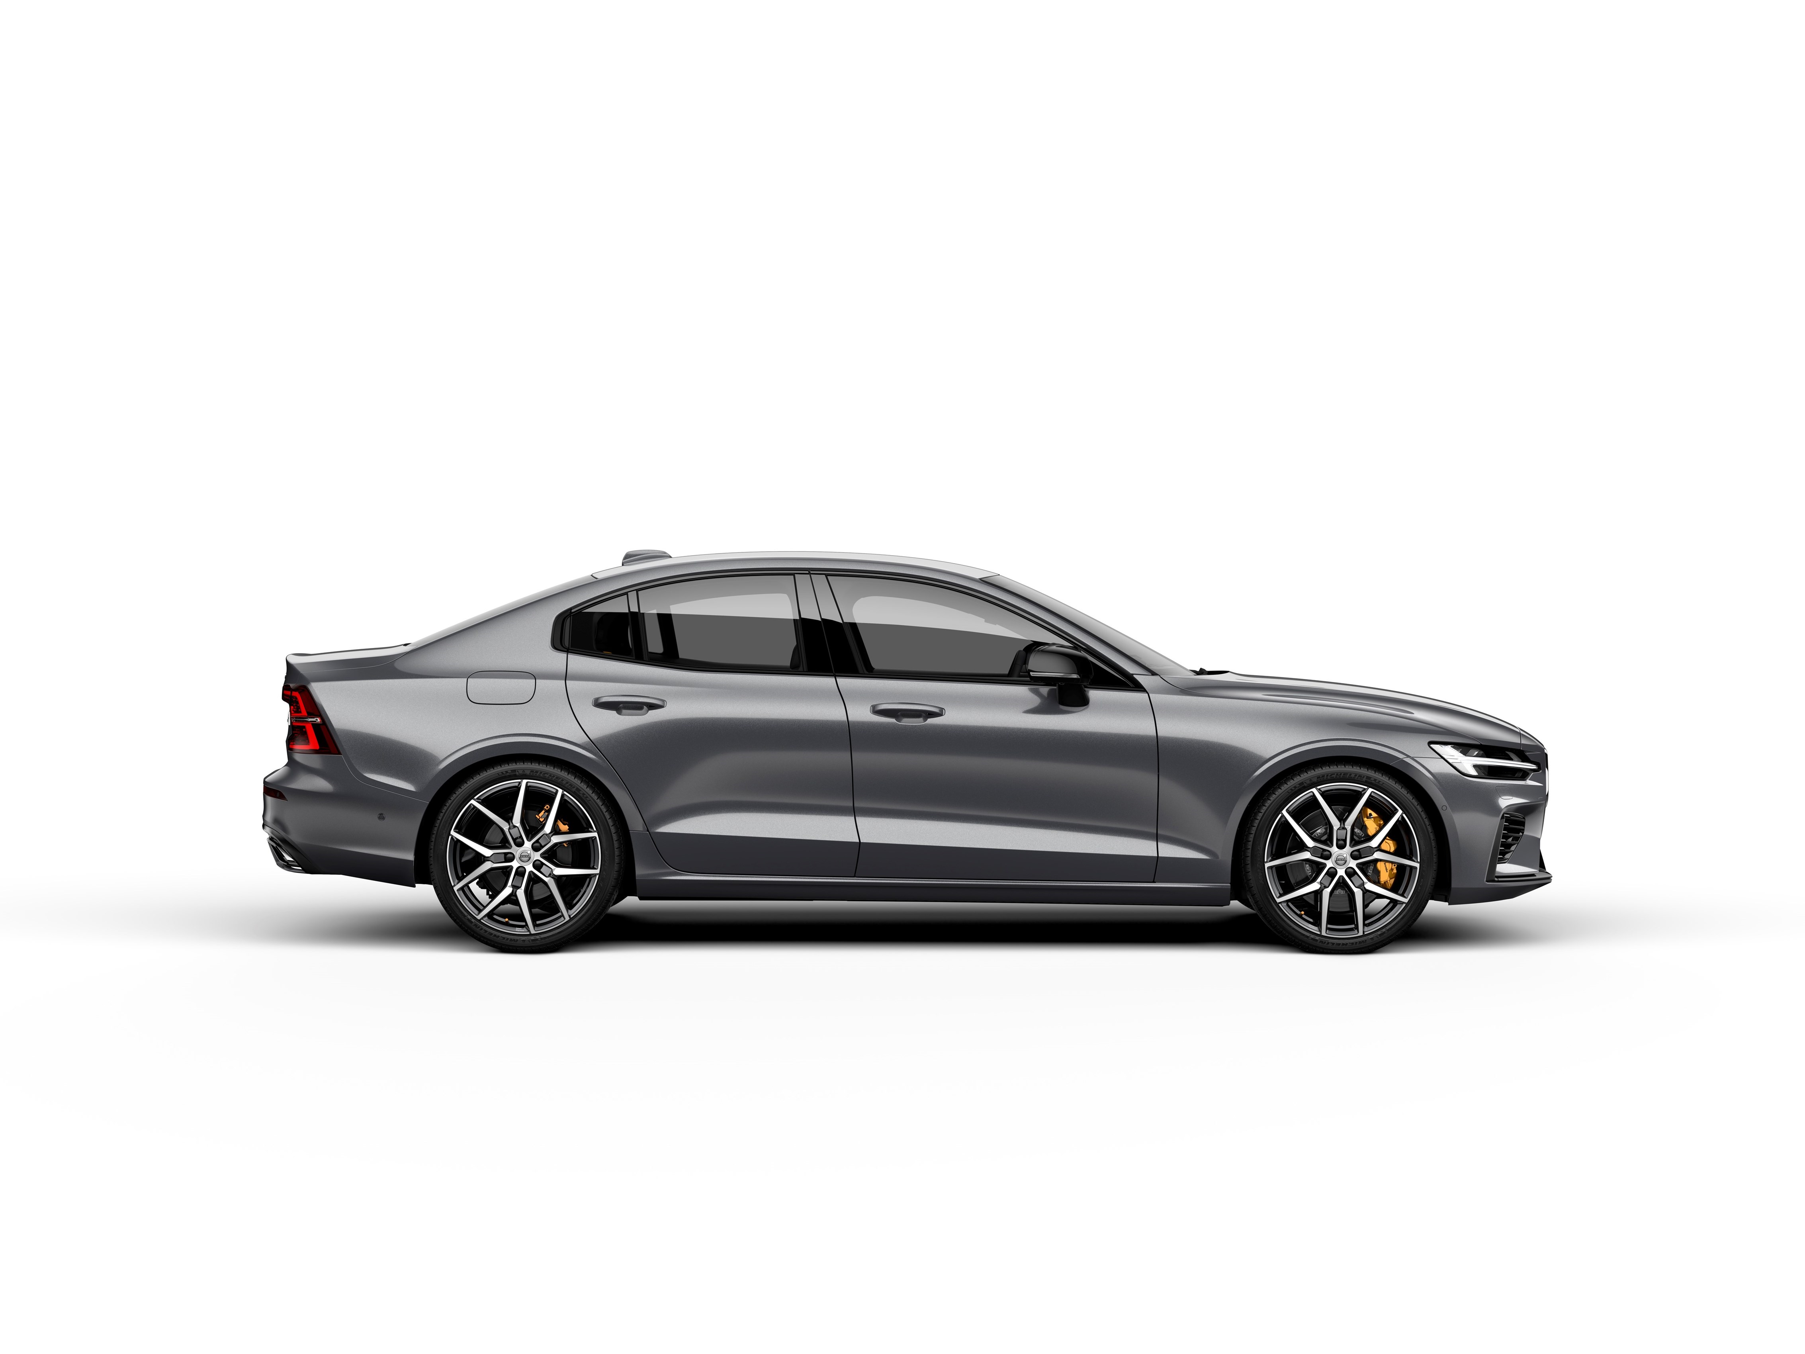
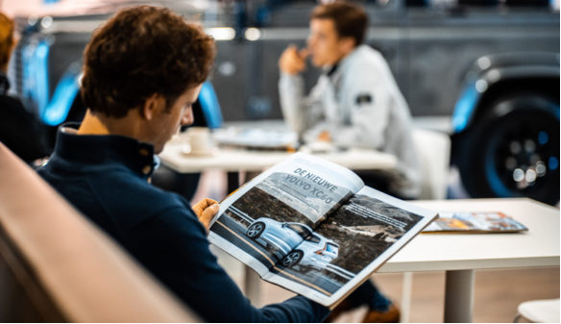

Vision: By 2030, injury protection performances of new cars will be assessed for both women and men!
Benefits:
Inclusive crash safety assessment
Best performing innovations identified
Improved safety for everyone
Notes:
With the vision that before 2030 we will be able to assess not only the safety of the new features in vehicles but also how they protect both males and females in the crash configurates that various degrees of autonomous driving brings.
My vision is that by 2030 the safety performances of new cars will be assessed both for men and women.
Such assessment would benefit the most robust technical solution in terms on injury prevention and would identify all ready in a new car what techical solution that worked best. This way we would not have to wait for this knowledge beeing provied from used cars.
That would meen that when bying a new car, you as buyer, would be able to pick the car that provide the best protection for all adults.

Slide 5
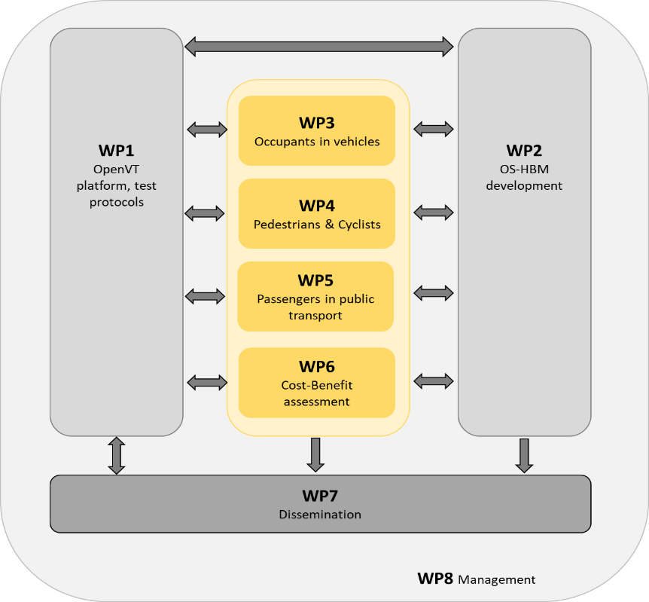
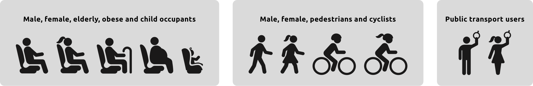

Slide 6
Contact:
Astrid Linder
Astrid.linder@vti.se
+46 708 286468

